Slide 1









Trade Tiger
PROVE IT.
Publish to the blockchain.
Contributors
Andrew Altman, Laramie Dunlap,
Joe Geoghegan, Ying Fu, Lauren Krohn

Slide 2

Trade Tiger
Trade Tiger:
A radically transparent
financial publishing platform.
Stock data and real-time trading functionality provided by Alpaca API.
PROVE IT.
Publish to the blockchain.

Slide 3

Financial Planning and Advice US Market size (2022)
$59.3 BILLION
IBISWorld Industry Statistics, updated July 27, 2022
Trade Tiger

Slide 4




The industry spans everything from publishing giants…
Seeking Alpha: $ 163.2 million
Motley Fool: $ 239.6 million
Morningstar: $ 1.6 billion
Forbes: $ 10.5 billion
Bloomberg: $ 11.6 billion
Trade Tiger

Slide 5

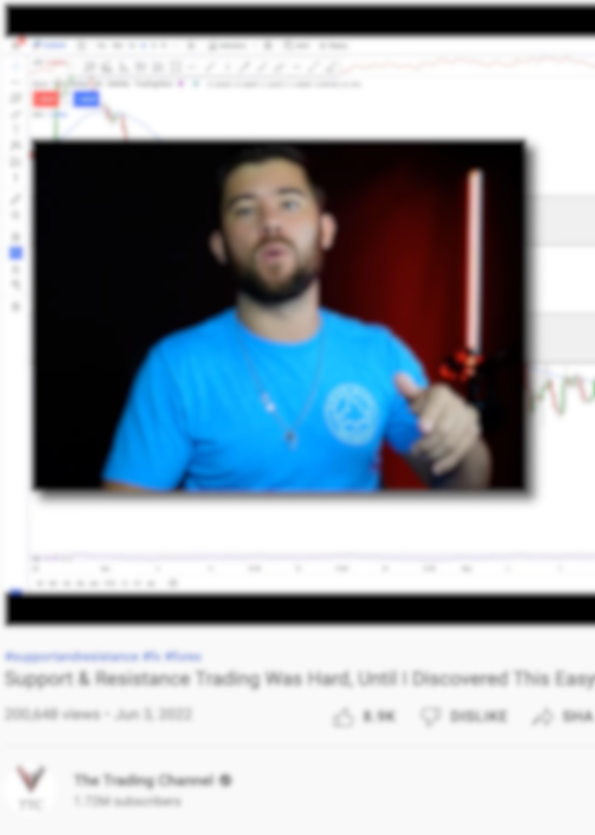

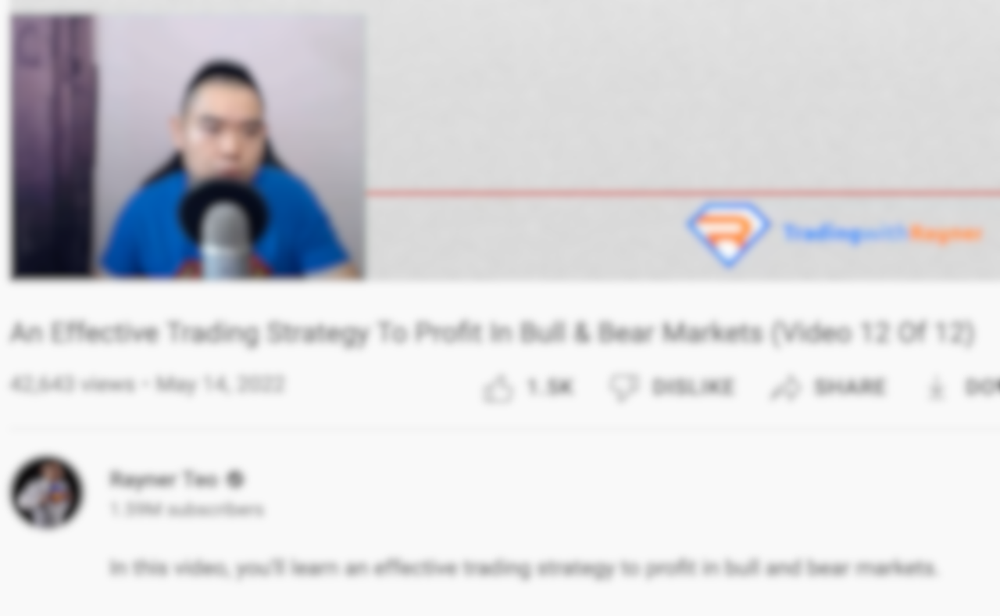
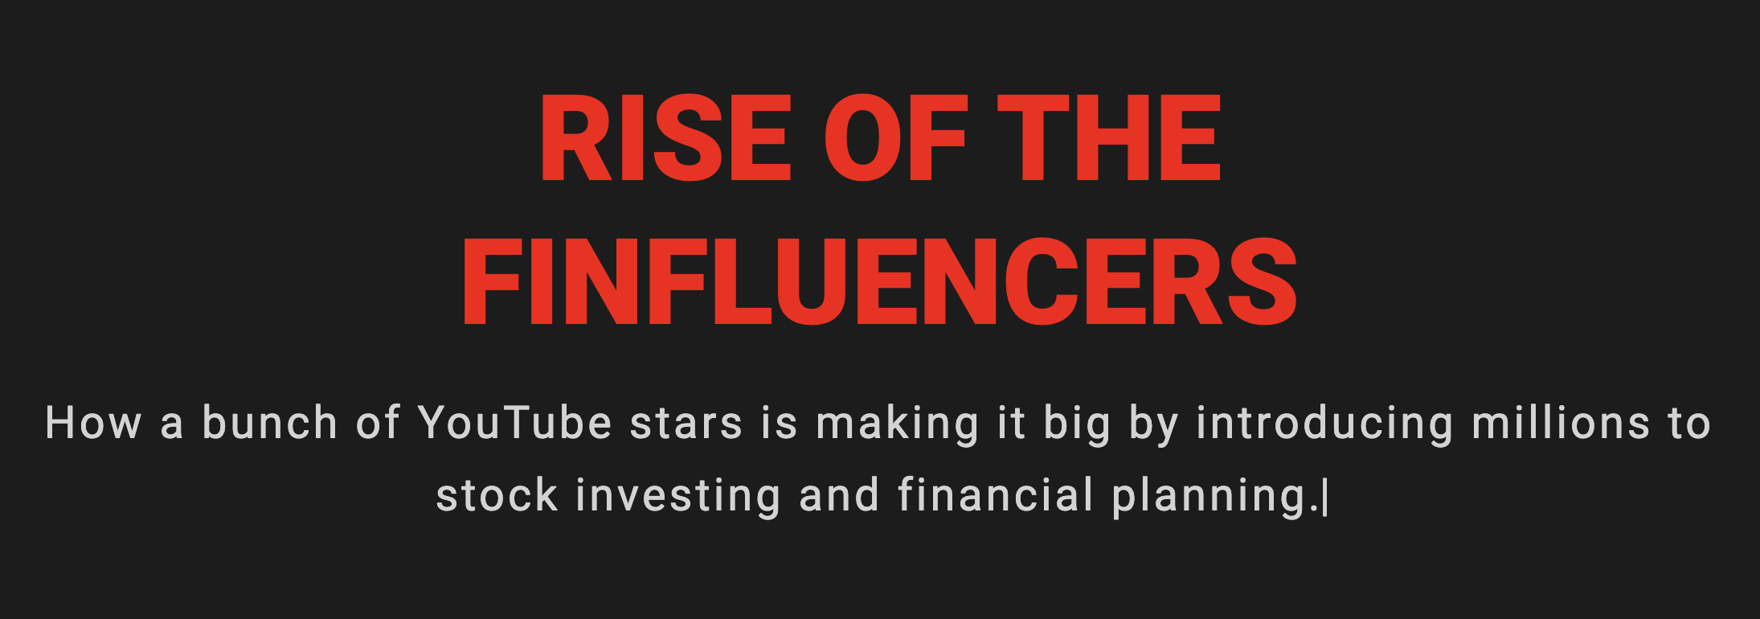


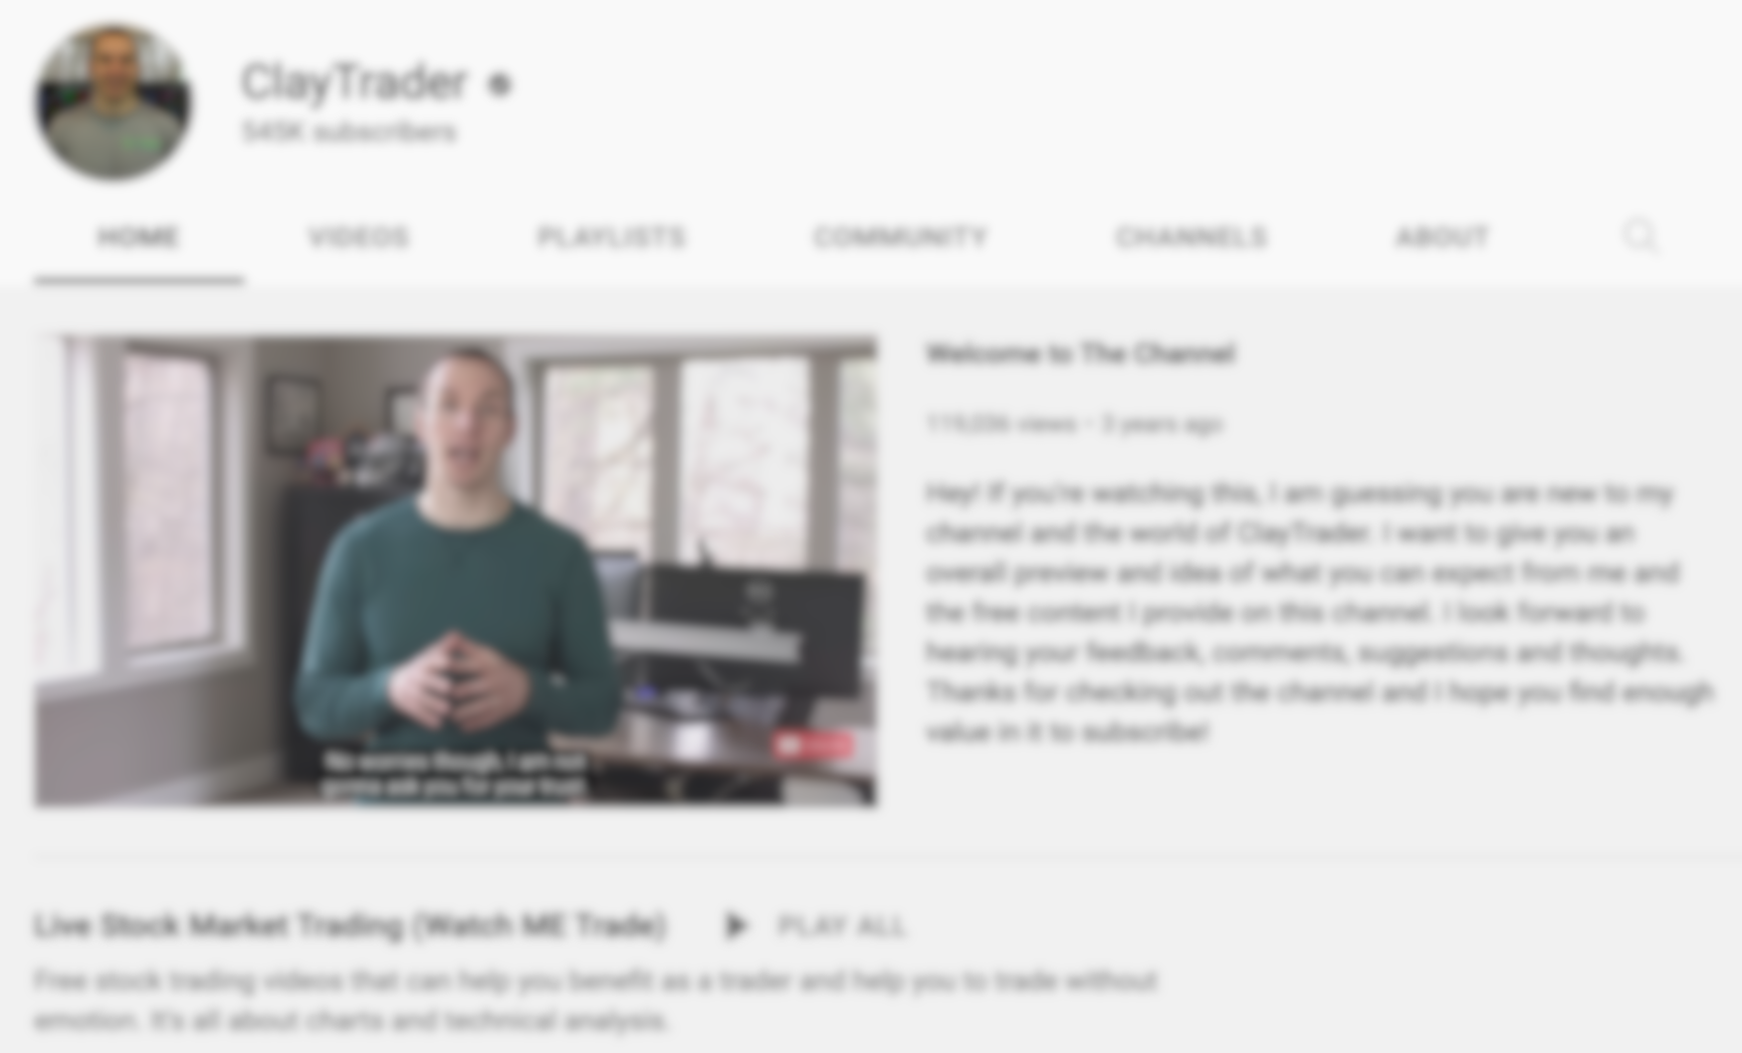
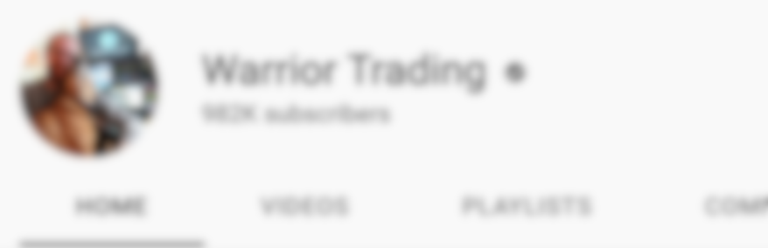
… to social media “Finfluencers”…
Influencer Market (2022): $ 16 billion
Influencer Projection (2025): $ 650 billion
Trade Tiger

Slide 6

… to the hybrid platforms and financial “gurus” in between.
Raging Bull makes $6,872
per minute
T3 Live: $ 38.2 million
Simpler Trading: $ 39.3 million
Raging Bull: $ 60.2 million
Trade Tiger

Slide 7

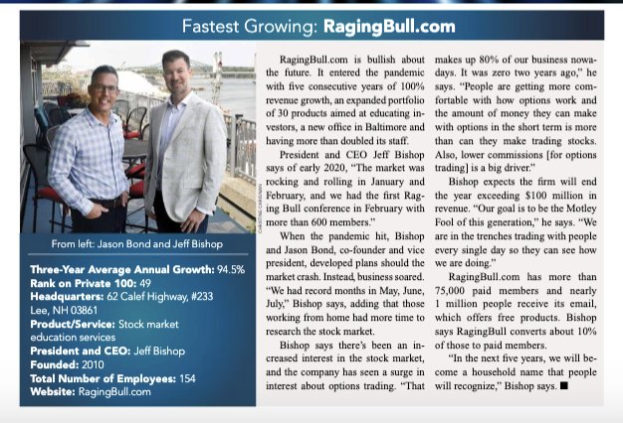


Financial “Gurus”
bank on blind trust.
Raging Bull: 2020

Slide 8
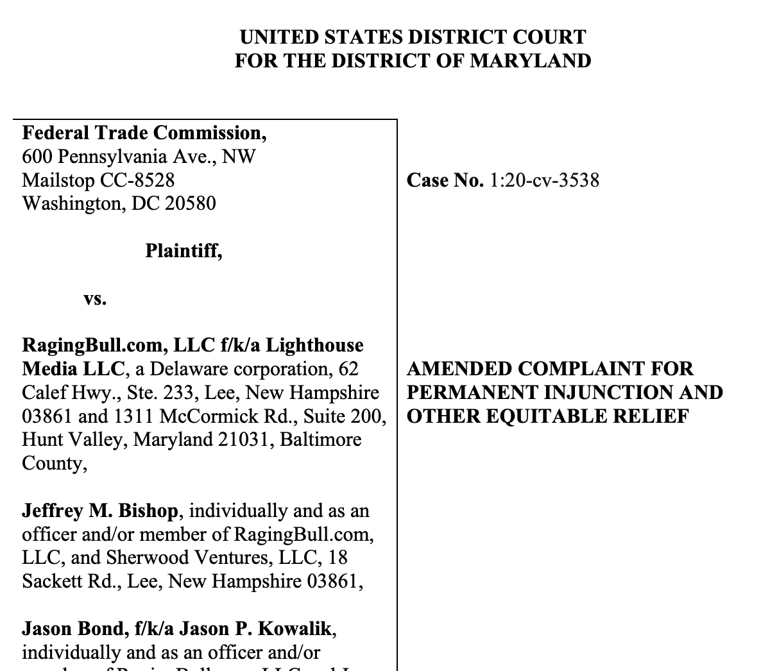

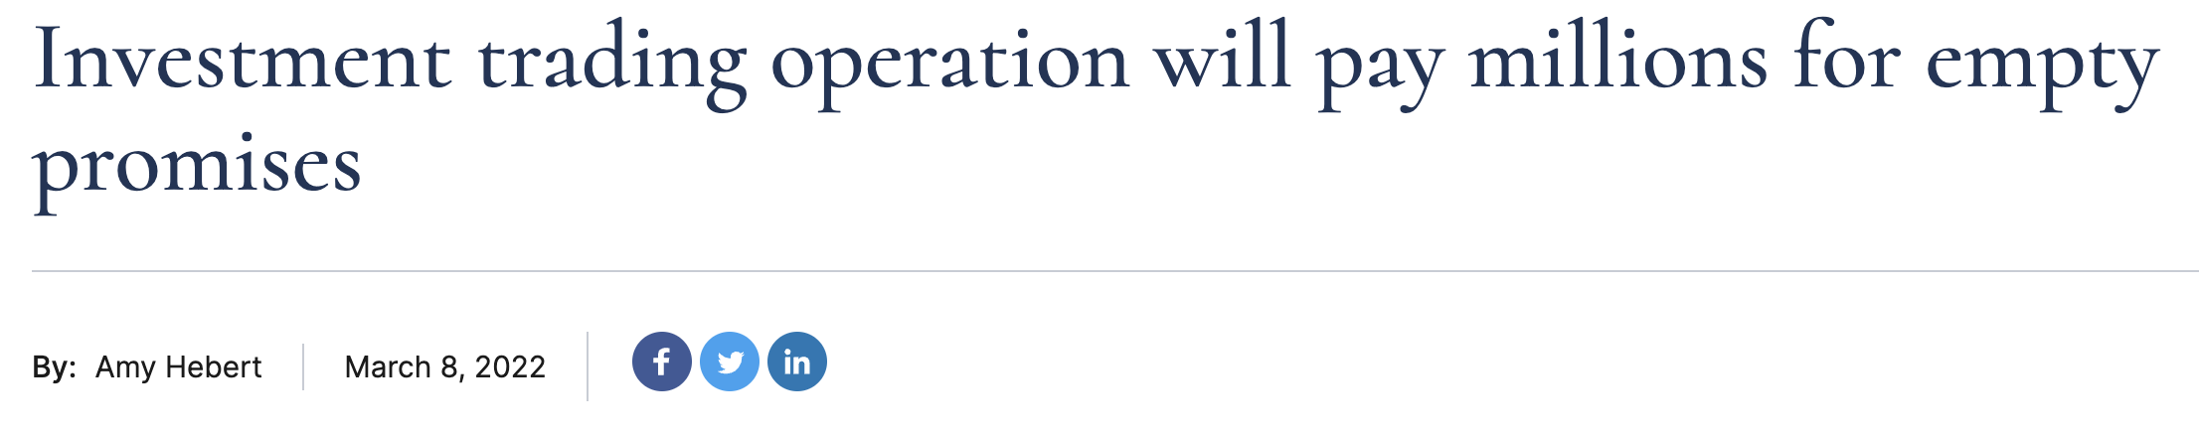
Raging Bull: 2022

Slide 9

Customers want transparency,
and bona fide traders are trying to show off their track record.
But can current tools provide true transparency?
Trade Tiger
PROVE IT.
Publish to the blockchain.

Slide 10
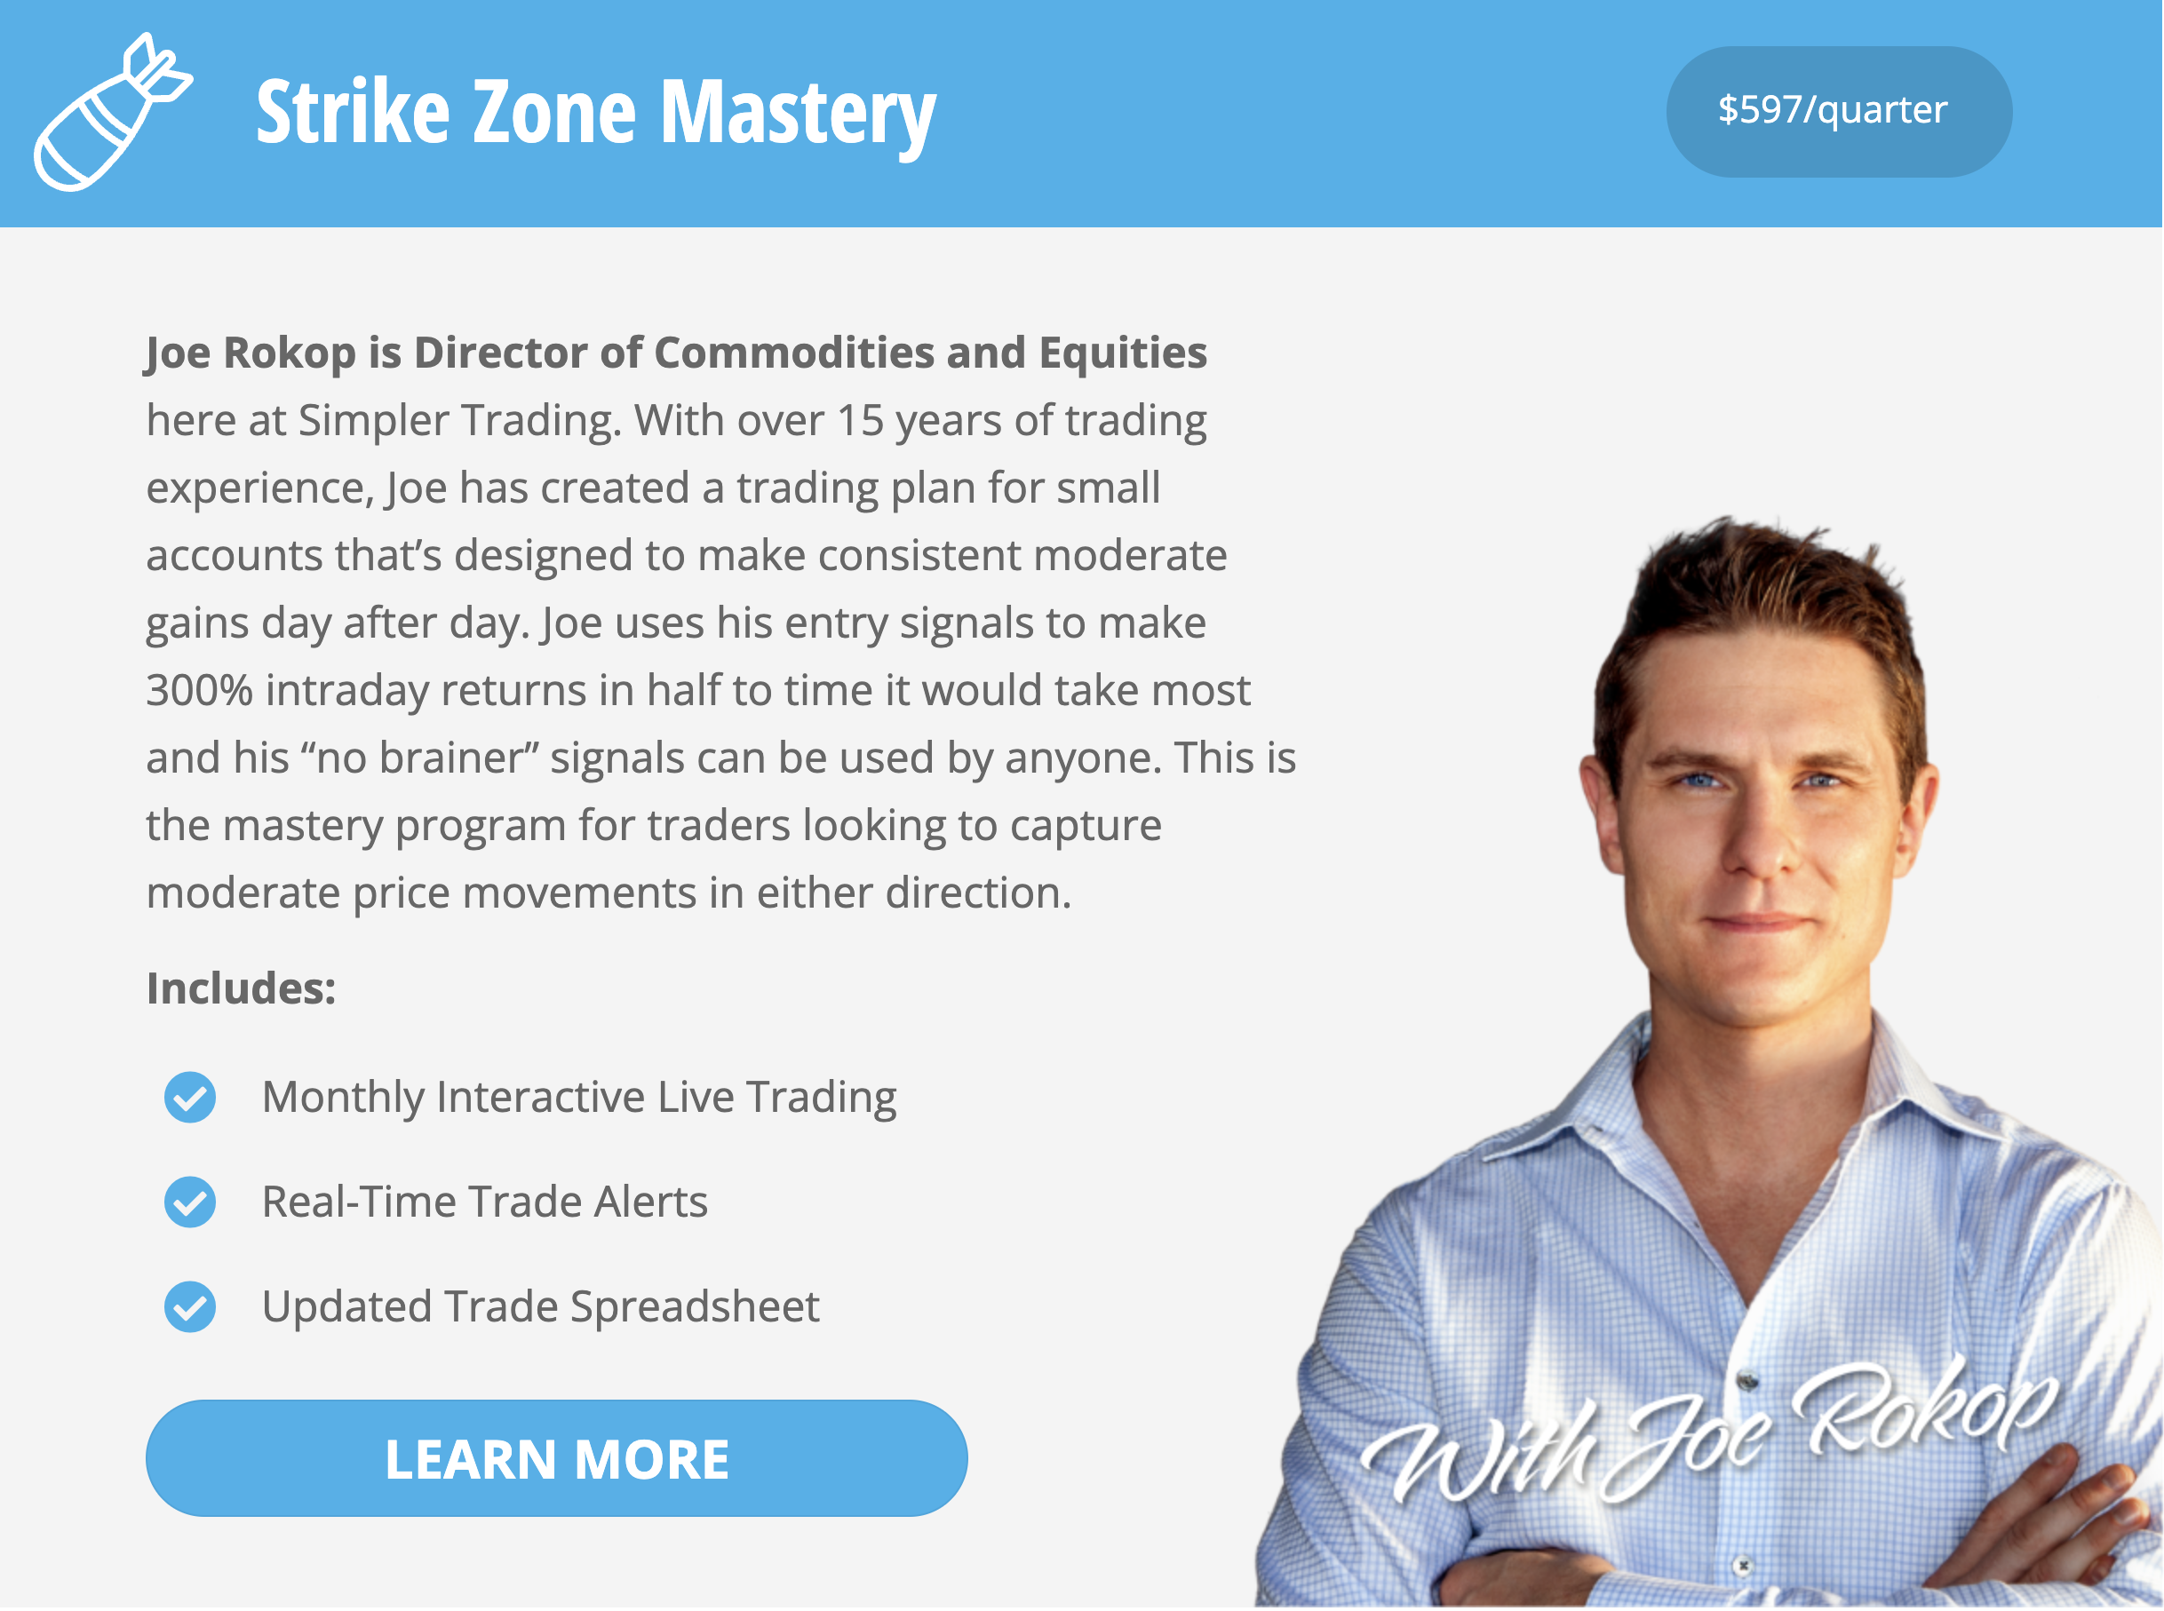


Marketing.
SHOW US YOUR TRACK RECORD!

Slide 11

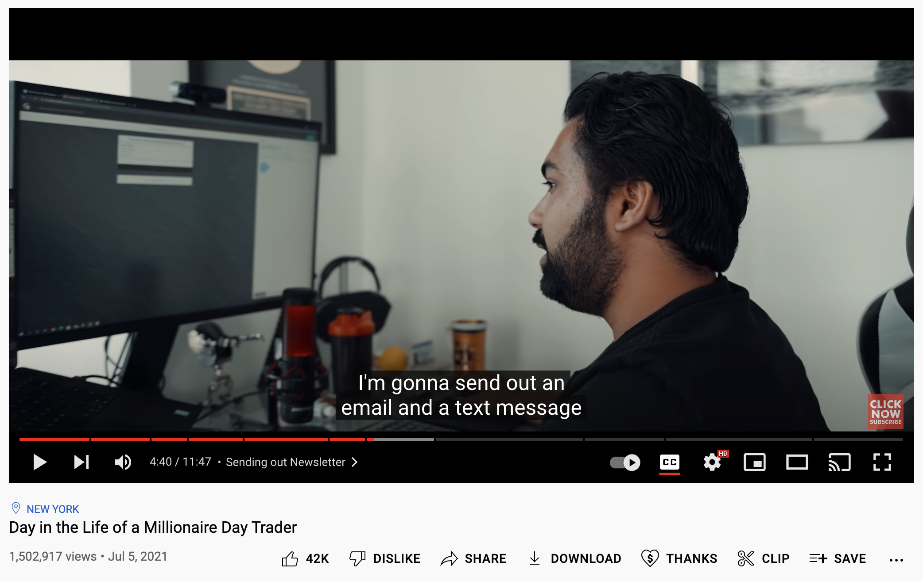
Livestream Trading.
WHAT ABOUT WHEN THE CAMERA IS OFF?

Slide 12
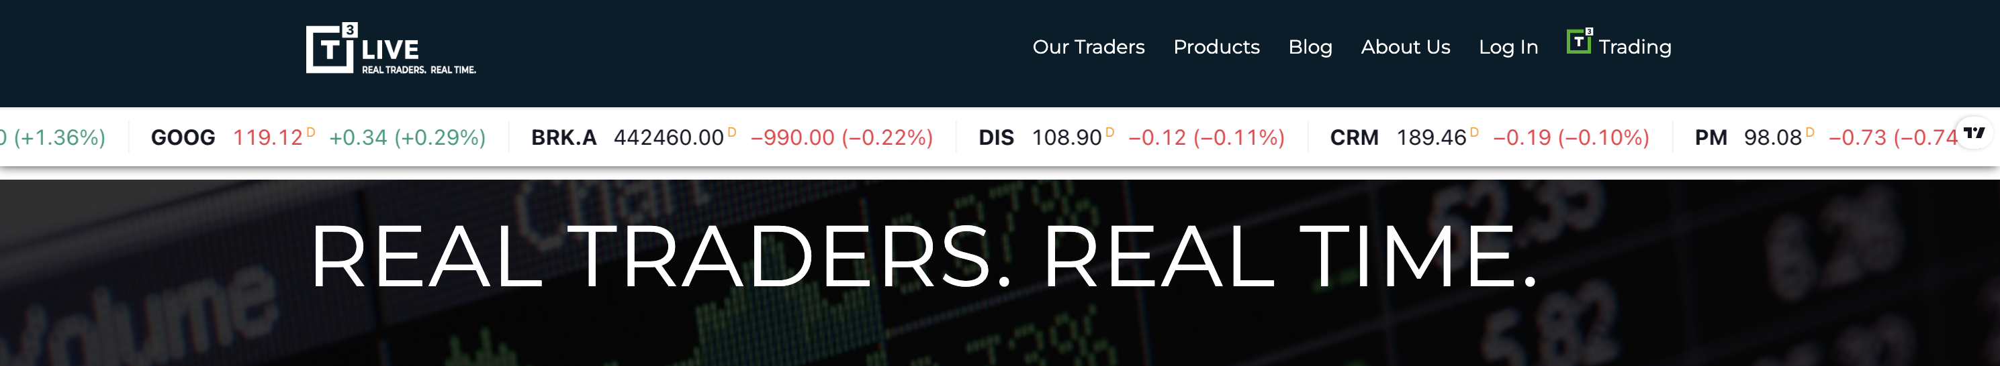
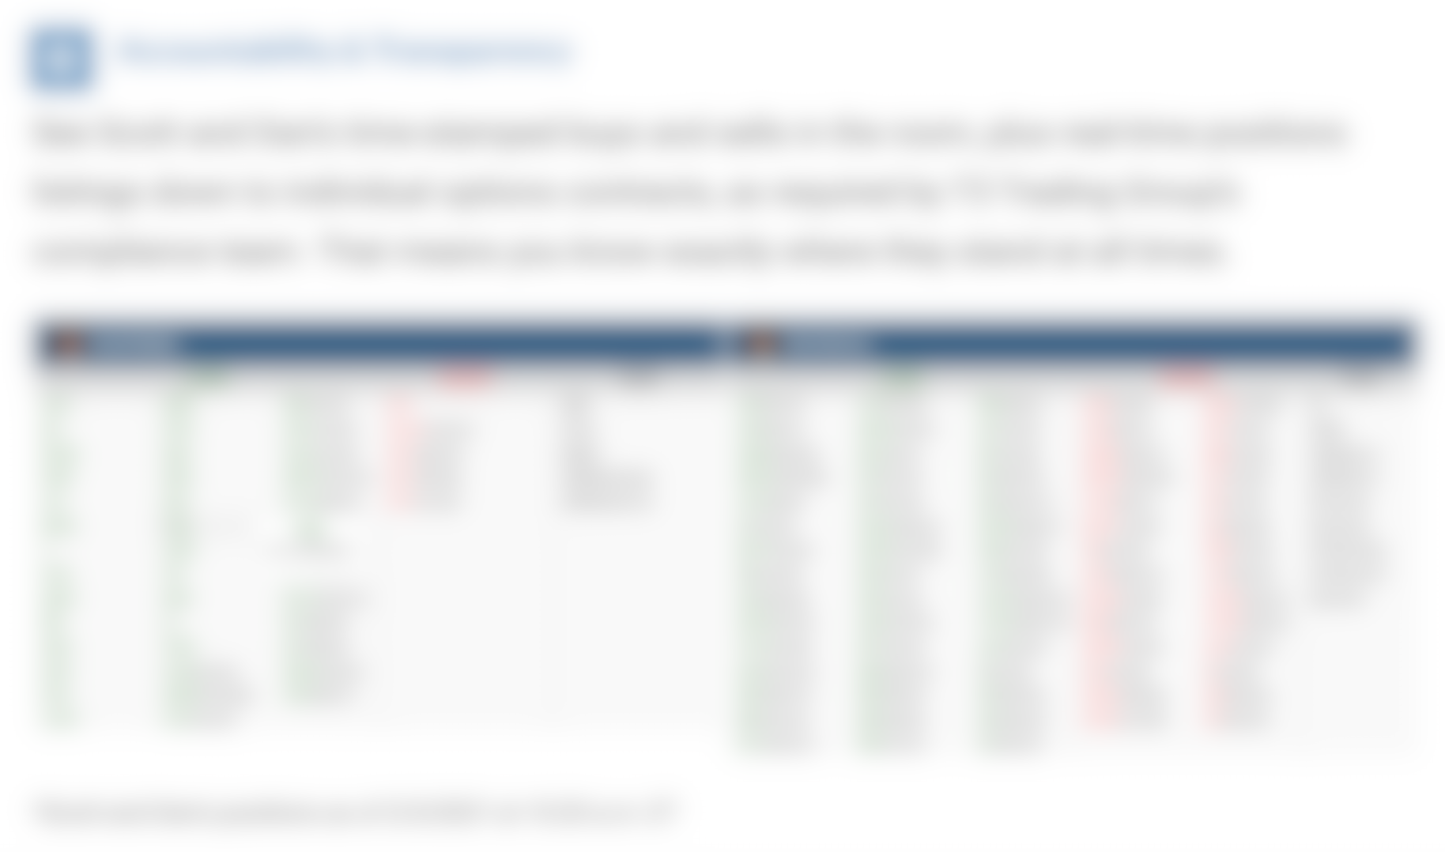

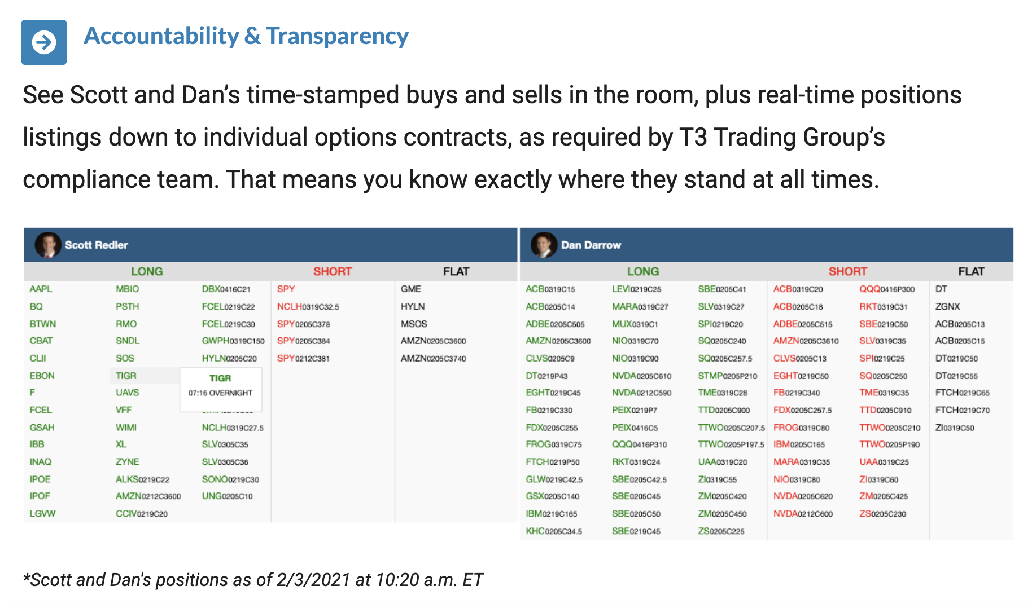
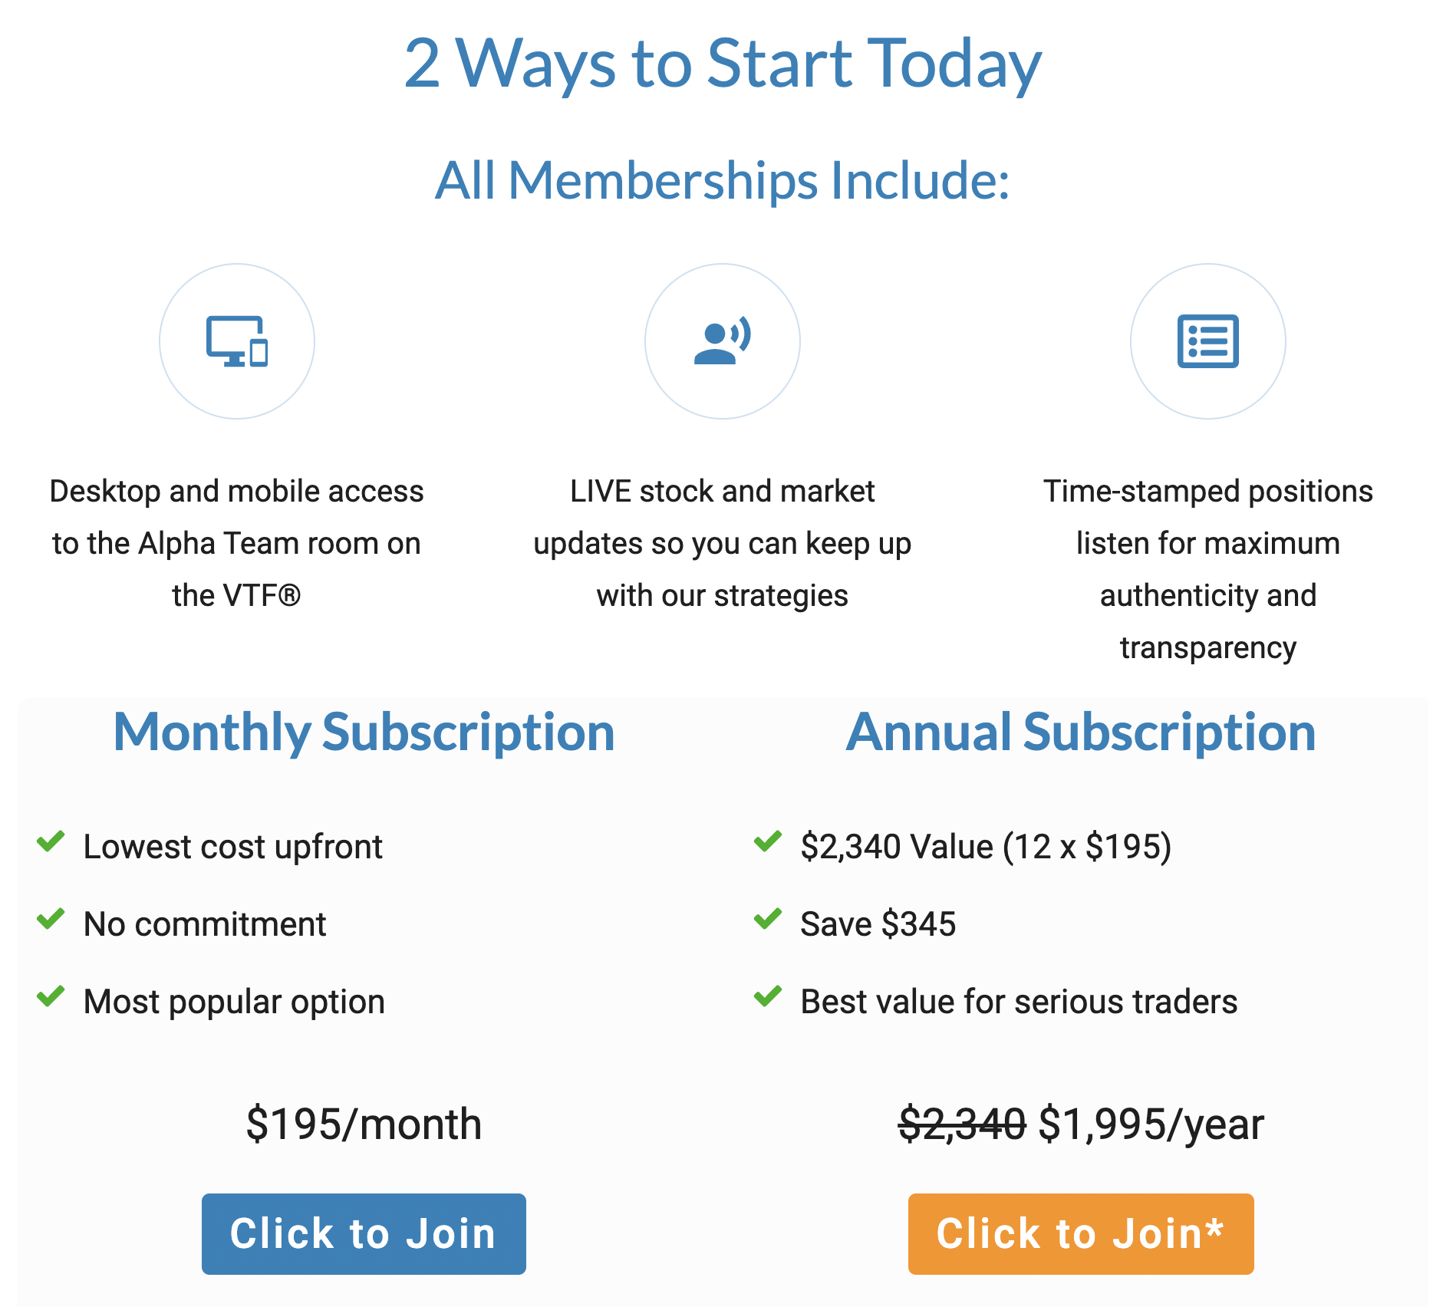
Verified Timestamps:
still need to trust the trader’s internal compliance team.
ALLEGEDLY

Slide 13
Talented traders are putting in the work to stake out successful strategies.
Subscribers are putting up hard-earned money for good financial advice.
We all deserve a platform that delivers total transparency.
Trade Tiger
PROVE IT.
Publish to the blockchain.

Slide 14

Trade Tiger
Financial Publishing with a Backbone –
a Blockchain Backbone.
Real-time public ledger - all trades instantly validated.
Effortless data tracking.
Automated subscription handling.
Trade Tiger
PROVE IT.
Publish to the blockchain.

Slide 15



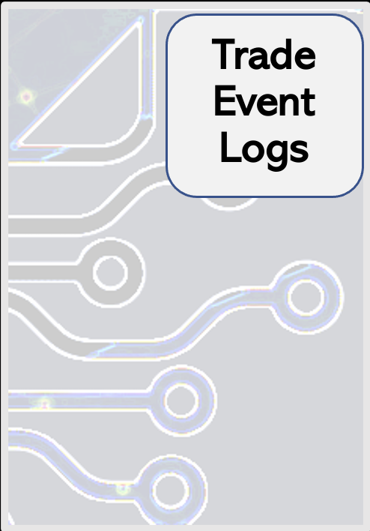




Tiger Deployer
Trade Logger
Trade Logs
Trader 1
Trade Tiger

Slide 16
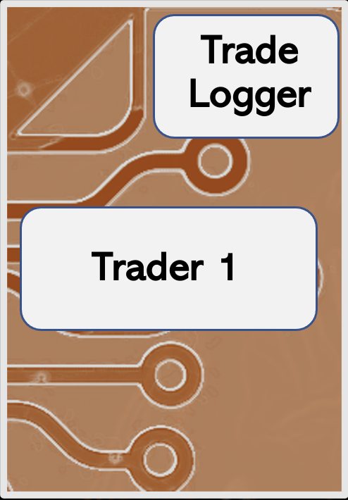
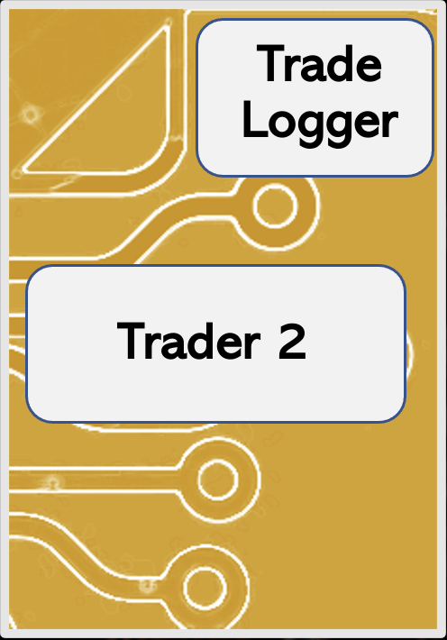
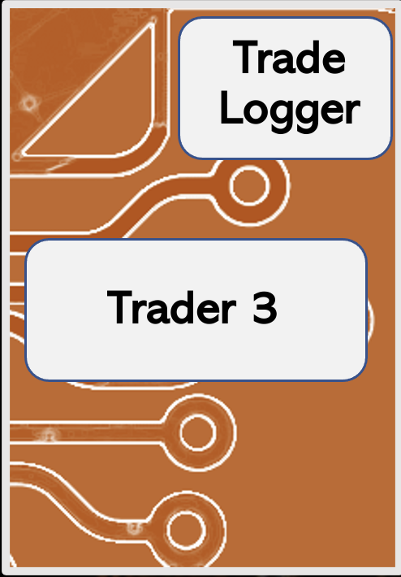
Trader 1
Trader 3
Trader 2
Trade Tiger

Slide 17
Trader 2
Trader 1
T r a d e T i g e r

Slide 18
Trader 1
Trader 2
T r a d e T i g e r

Slide 19
Subscribers
(Trader 1)
Subscribers
(Trader 2)
Trader 1
Trader 2
T r a d e T i g e r

Slide 20
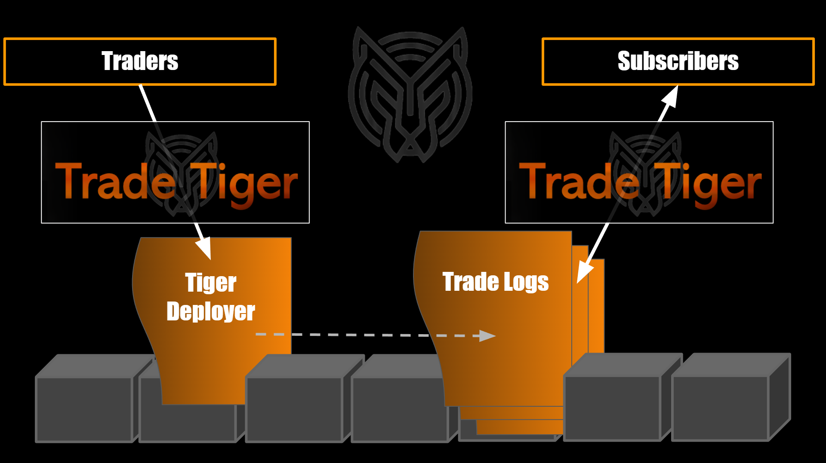
Visual representation
Trade Tiger

Slide 21
Visual representation
Trade Tiger

Slide 22
Trade Tiger Demo
Trade Tiger
Demo
PROVE IT.
Publish to the blockchain.

Slide 23
Trade Tiger
Real-time Public Ledger
Verified positions are posted to the public blockchain.
Traders earn subscriber trust on a $0 marketing budget.
Subscribers trust the traders they follow put their money where their mouth is and don’t re-write history.

Slide 24
Trade Tiger
Effortless Data Collection
Positions are verified and logged at the same time.
Personal metrics and data are always accurate and easily accessible.
Trade Tiger publishes a leaderboard to foster competition and subscriber interest.

Slide 25
Trade Tiger
Automated Subscription Handling
Subscriber lists are tracked on the blockchain and integrated into trader activity.
Traders can automate email alerts to coincide with trading events.
Subscribers are protected by the Tiger Trade grading system and money back guarantee.

Slide 26
Trade Tiger
TT Next Level Developments:
Livestream trading platform.
TTToken will represent $USD subscriber fees 1:1 on the blockchain, allowing users to take advantage of seamless blockchain transactions without the volatility risk.
Traders can become verifiers for other traders.
Trade Tiger
PROVE IT.
Publish to the blockchain.

